Slide 1
ISTA 350
Statistics and Representing Data
Spring 2020

Slide 2
Data: Discrete vs Continuous
Discrete data consists of data points whose available values are restricted to a set of isolated values, which may or may not be numerical.
Ex:
{1, 2, 3, 4, 5, 6}
{0, 0.5, 1, ..., 99.5, 100}
{male, female}
Nonnumeric discrete data are called categorical data.

Slide 3
Data: Discrete vs Continuous
Continuous data can take on any value over an interval. Continuous data are always numbers.
Ex. Anything you can measure
time, weight, distance, height

Slide 4
Random variables
A random variable is a quantity that takes on different values. We give it a name or a symbol so we can refer to it.
Each possible value has a probability or probability density associated with it. This is what distinguishes a random variable from any other sort of mathematical variable.
A given data set contains values for one or more random variables.

Slide 5
Frequency Distributions
Every dataset has a frequency distribution associated with it.
The frequency distribution for a discrete dataset tells us how often each of the possible values occurs.
The frequency distribution of a continuous dataset tells how often values fall within certain ranges.
Looking at the shape of a frequency distribution can often tell us a lot about a random variable.

Slide 6
Frequency Distributions:
Discrete vs Continuous Random Variables
To get the frequency distribution of a discrete random variable, simply count the number of times each value occurs.
To get the frequency distribution for a continuous random variable, break up the number line into equal sized intervals and count the number of data points that fall into each interval.
Visualize frequency distributions with bar charts (discrete data) and histograms (continuous data)

Slide 7
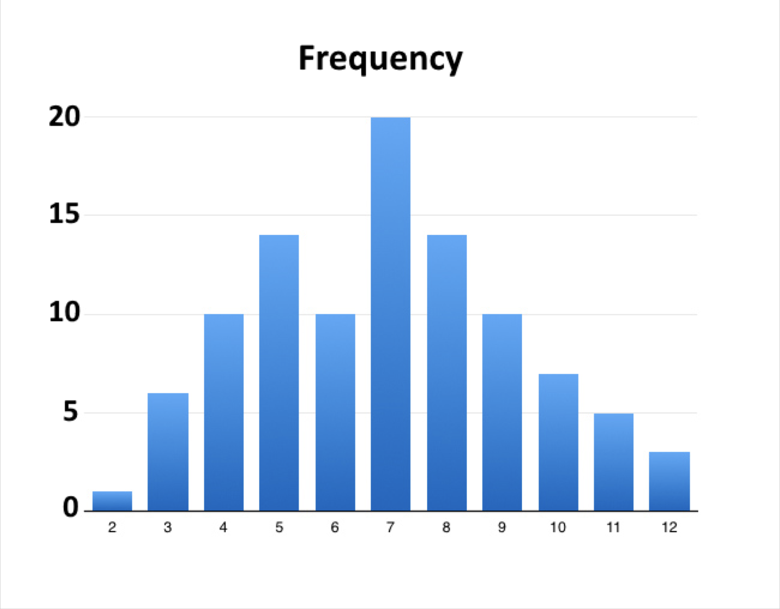
Discrete Data - Bar Charts
The chart on the left displays the results of rolling two dice 100 times.
There should be spaces between the bars.
Bar charts can be used to visualize the frequency distributions of discrete data sets.
http://www.brightpips.com/wp-content/uploads/2014/05/two-dice-100-rolls-chart.jpg

Slide 8
Frequencies and Continuous Distributions
If we want to investigate the shape of the frequency distribution of a continuous random variable, we need to be able to represent the data points in terms of frequencies.
Break the number line into intervals and count the number of data points that fall within each interval.
We’re essentially putting them into bins and counting the number in each bin.
This is called discretizing the data.

Slide 9
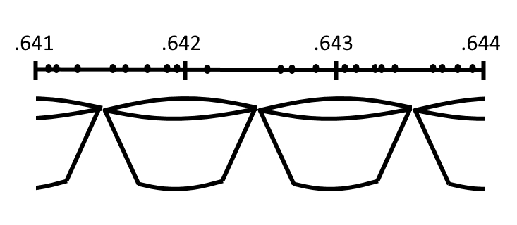
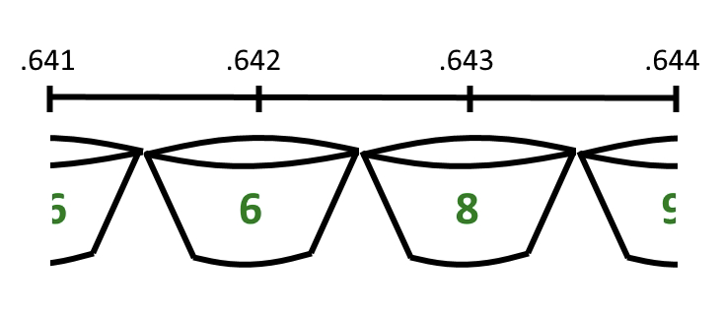
Discretizing the data
Example: our bin width is 0.001, so we can discretize by rounding.

Slide 10
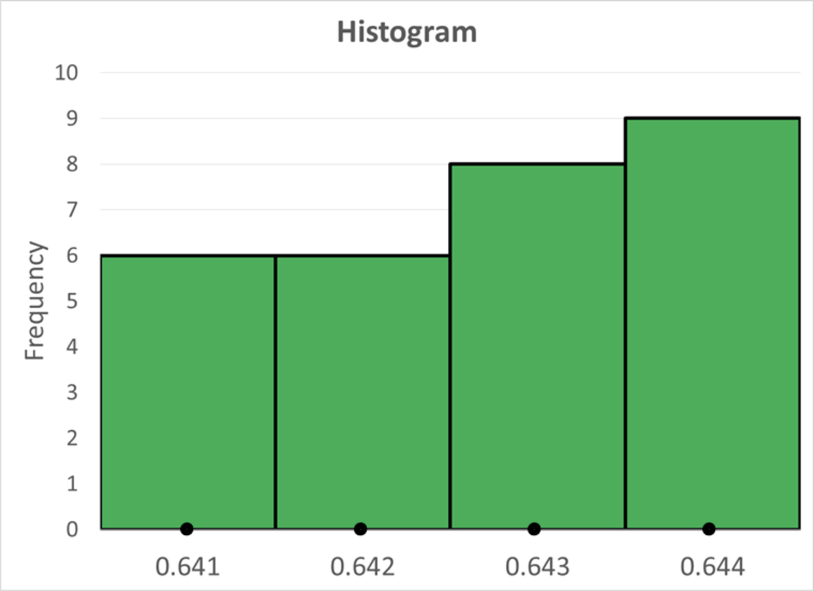
Continuous Data - Histograms

Slide 11
Continuous Data - Histograms
There should never be spaces between the bars.
Histograms can be used to visualize the frequency distributions of continuous data sets.

Slide 12
Probability Distributions
We can turn frequency distributions into estimated probability distributions.
The estimated probability distributions will have exactly the same shape as the frequency distributions - the numbers are just scaled.
Probability distributions are what people are really interested in because they allow us to make predictions.

Slide 13
Probability Distributions: Discrete Data
Probability distributions for discrete random variables are called probability mass functions.
To get an estimated probability mass function from a frequency distribution, divide the frequencies by the total number of data points, i.e., the number of observations, N.
The sum of all of the resulting estimated probabilities is 1.

Slide 14
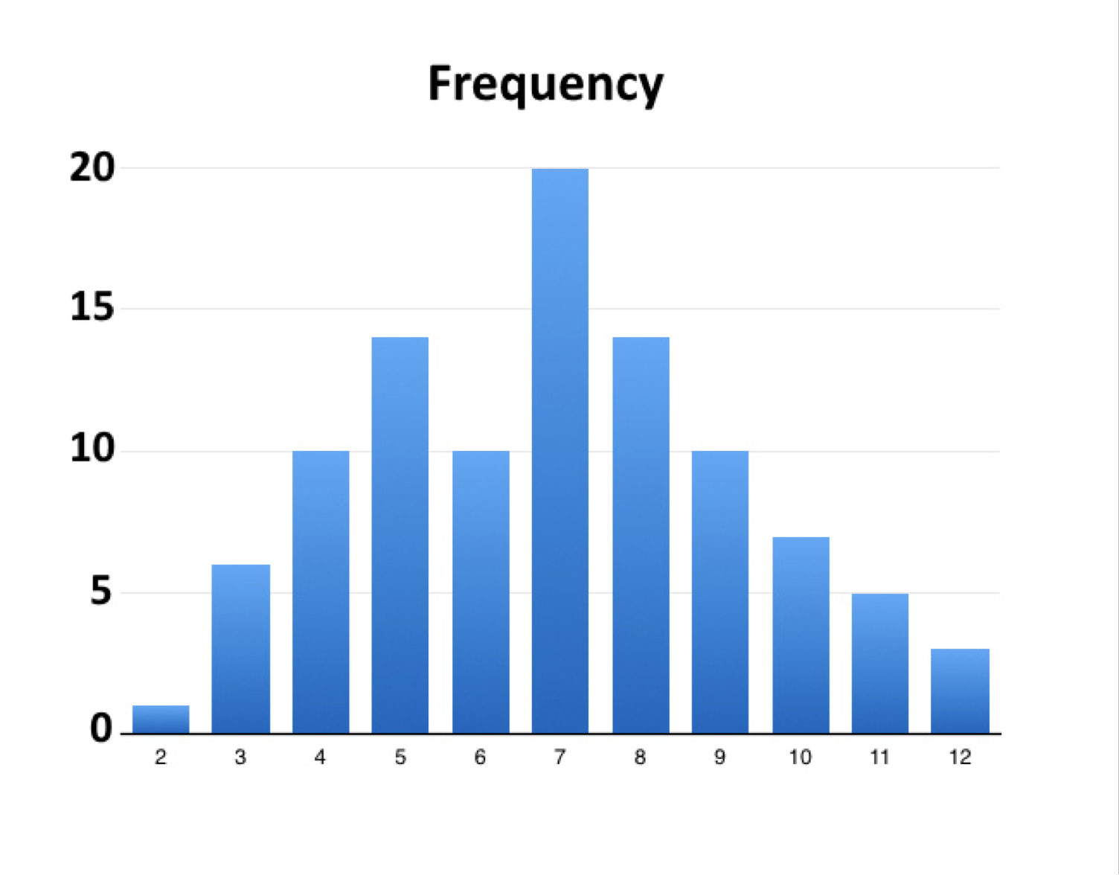
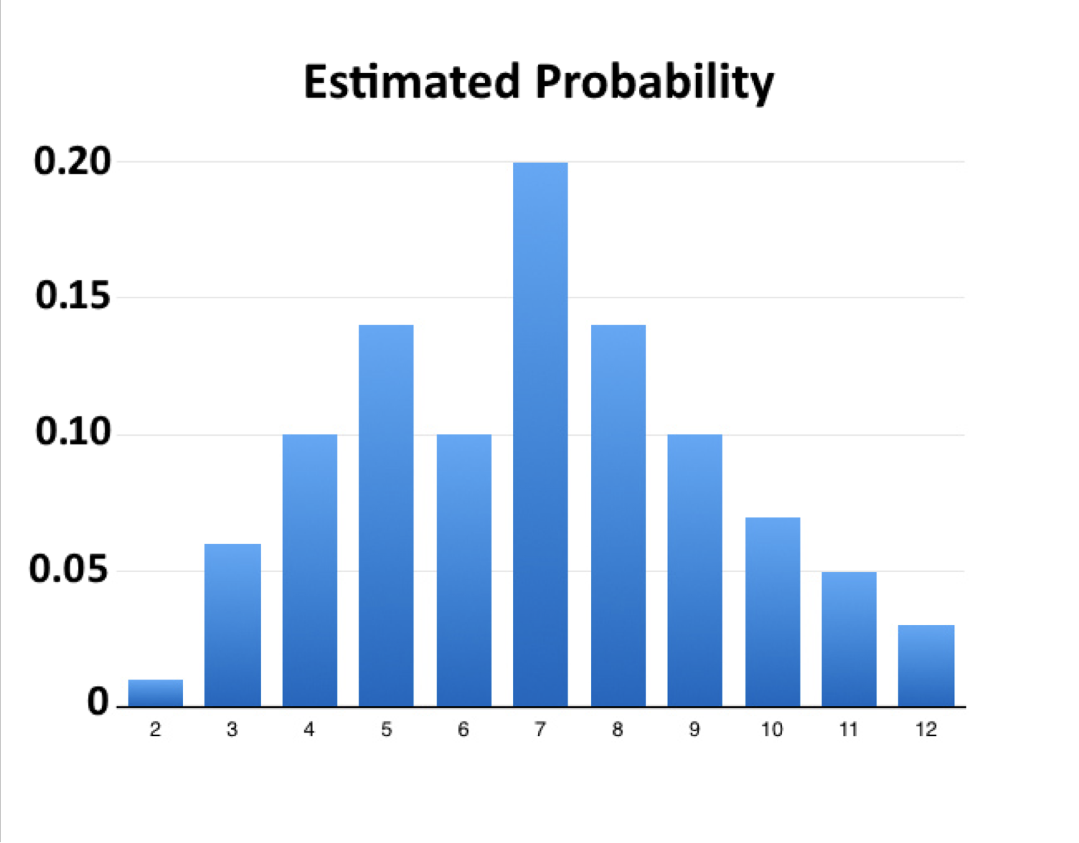
Discrete Data: Estimating Probabilities
The results of rolling two dice 100 times.

Slide 15
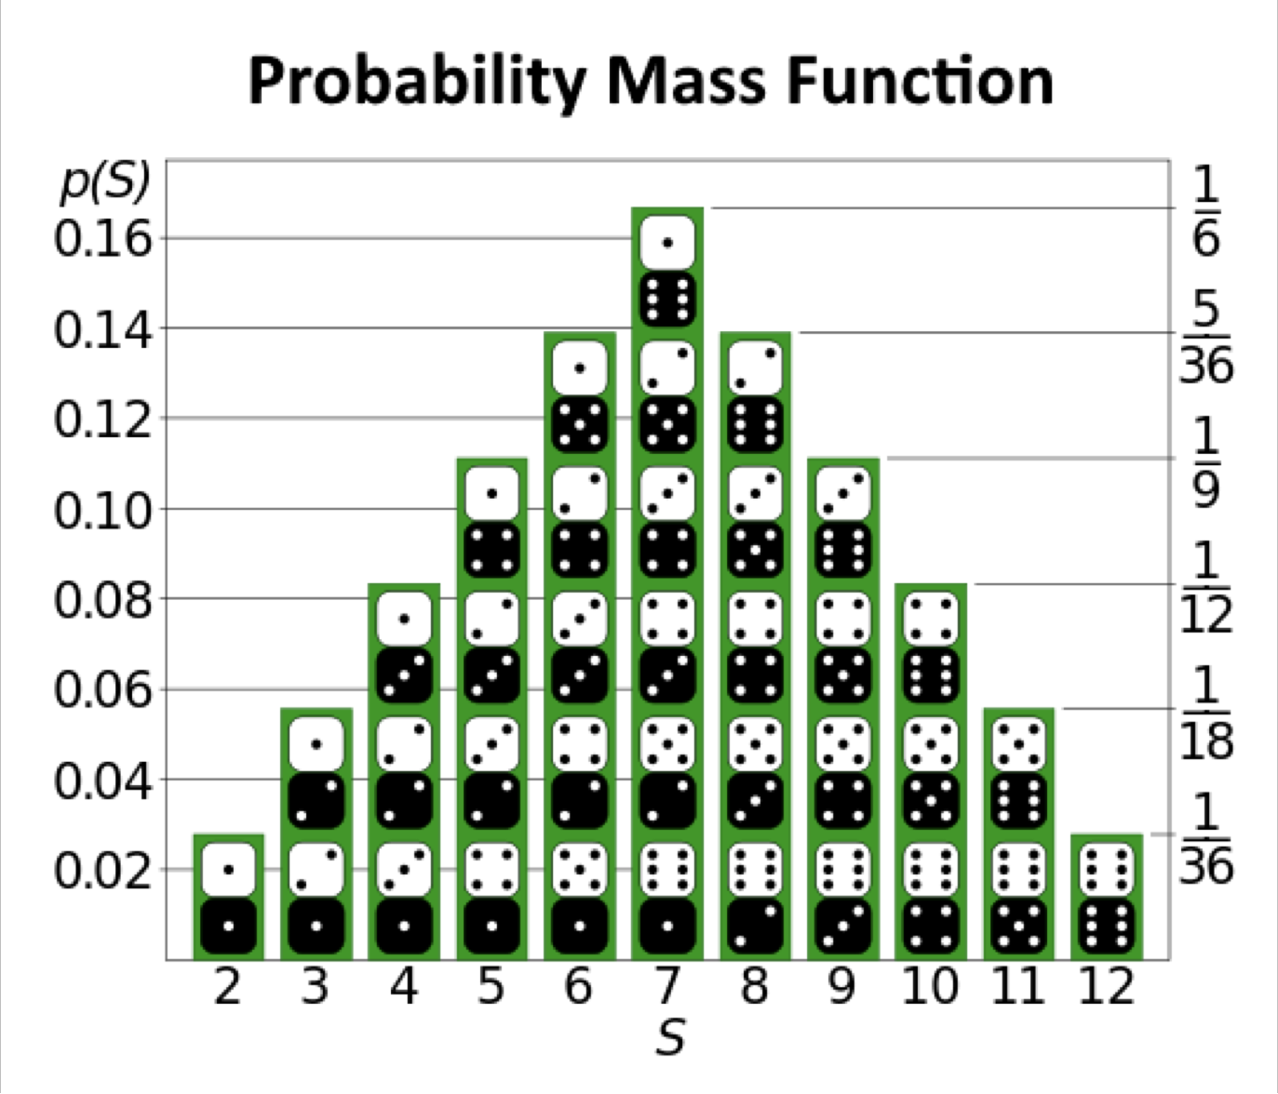
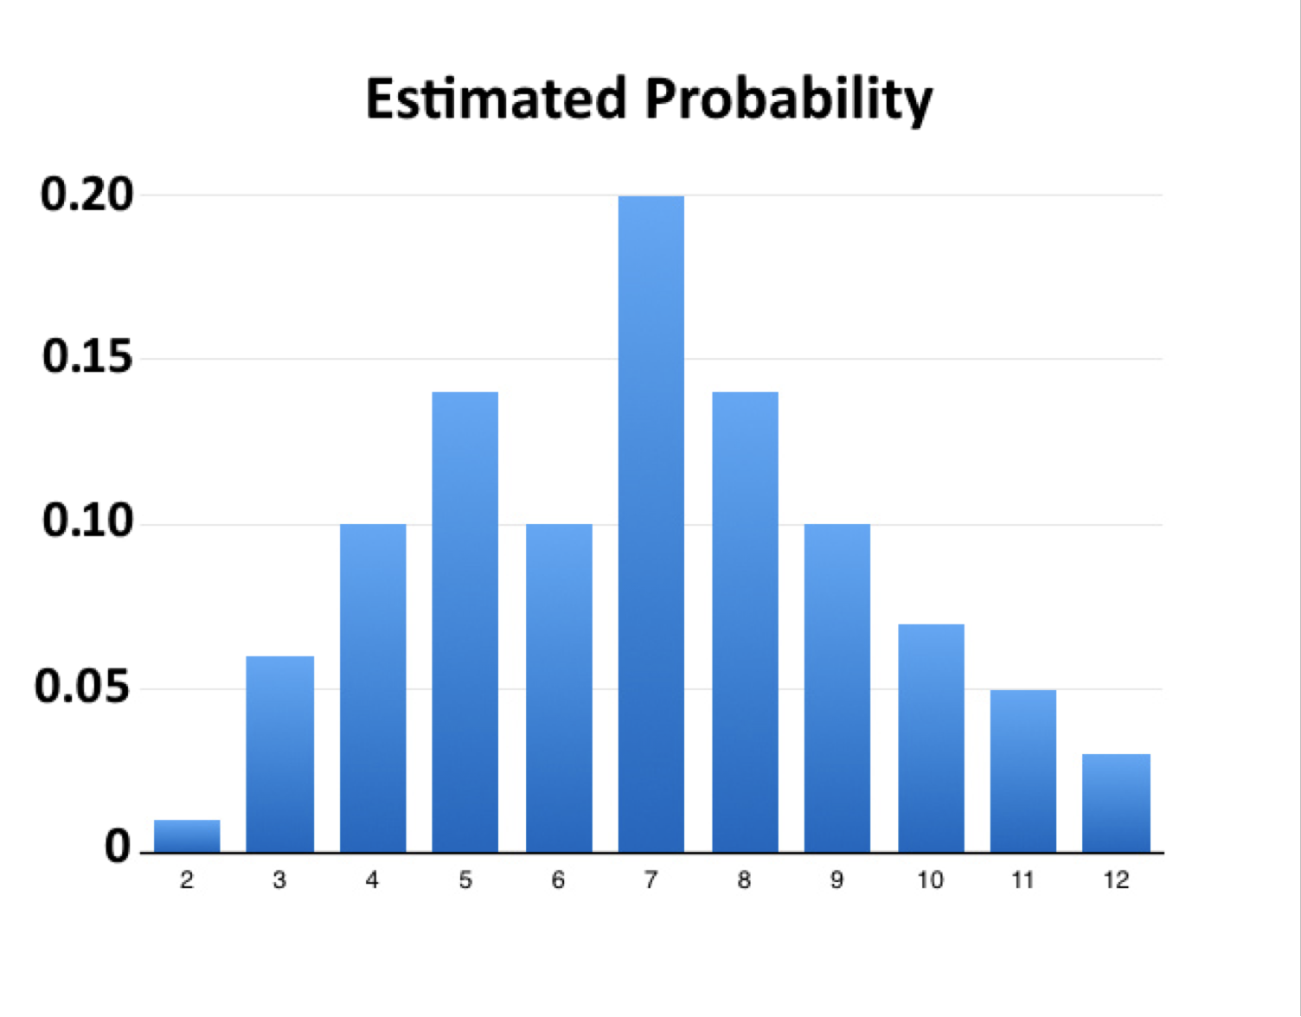
How good was our estimate?
By Tim Stellmach - Own work using Inkscape and Open Office Draw software., Public Domain https://commons.wikimedia.org/w/index.php?curid=1220091

Slide 16
Continuous Data: Estimating Probabilities
Example: https://newonlinecourses.science.psu.edu/stat414/node/120/
The following numbers are the measured nose lengths (in millimeters) of 60 students:
38 50 38 40 35 52 45 50 40 32 40 47 70 55 51
43 40 45 45 55 37 50 45 45 55 50 45 35 52 32
45 50 40 40 50 41 41 40 40 46 45 40 43 45 42
45 45 48 45 45 35 45 45 40 45 40 40 45 35 52
Remember that, even though these values seem discrete, this is technically continuous data because we could, in theory, measure the length to infinite precision.

Slide 17
Steps to create a histogram of continuous data...
Determine the number, n, in the sample.
Determine our bin size (or k class intervals)
Determine the frequency of each class (i.e., how many values fall into each bin)
Calculate the relative frequency (proportion) of each class by dividing the bin frequencies by the total number sampled (n)
Calculate the density height by dividing the relative frequencies by the bin width
Notes:
60
0.5

Slide 18
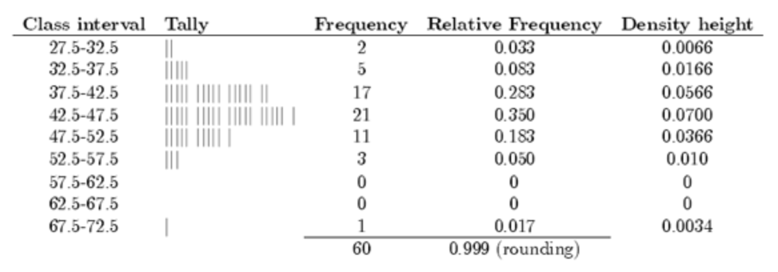
What our intervals would look like when bin width = 5mm

Slide 19
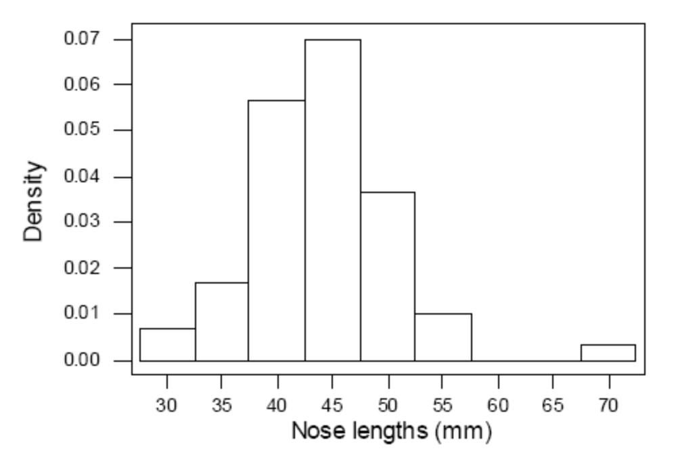
Nose Lengths Density Histogram

Slide 20
Complete the Lab 8 worksheet

